Slide 1


AI Tools for Developers
Notes:
LK

Slide 2

Peter Cosemans
Coach & Trainer @ Euricom
Intellua
Notes:
Me
Working on AI-applications
Started with AI back in 2018
Currently working on building an AI platform to build generic AI solutions
Started programming at the age of 13
First startup at the age of 18

Slide 3

Stijn Dams
Consultant @ Euricom
Notes:
PB

Slide 4

Lode Kennes
Venture Owner @ Intellua
Intellua
Notes:
Me
Working on AI-applications
Started with AI back in 2018
Currently working on building an AI platform to build generic AI solutions
Started programming at the age of 13
First startup at the age of 18

Slide 5
Content Agenda
01
02
Under-The-Hood
Overzicht AI Tooling
03
04
Project
Ethical & Advanced AI
05
Project Reflectie
Notes:
PB

Slide 6
Key concepts.
Key concepts and terminologies & Applications and impact of AI

Slide 7
Artificial Intelligence is a technology that enables computers and machines to simulate human learning, comprehension, problem solving, decision making, creativity and autonomy.

Slide 8
Large Language Models
Key Concepts
Large Language Models are AI systems trained to understand and generate human language.
Translation, Question Answering, Text Generation, Contextual Understanding, Summarization.
Notes:
They are not search engines. Trained on large corpora of text.

Slide 9
What does “GPT” stand for?

Slide 10
Large Language Models
Key Concepts
BERT
GPT
T5
Notes:
GPT-like Models
Example Sentence: "GPT-like models predict the next word in a sequence, making text generation as intuitive as forming a sentence word by word."
Real-life Application: OpenAI uses GPT models to power ChatGPT, assisting in generating human-like text responses across various applications, from customer service bots to content creation.
Slide 2: BERT-like Models
Example Sentence: "BERT-like models understand the meaning of a word in its context by looking at the words around it, much like understanding a joke by knowing the backstory."
Real-life Application: Google uses BERT to enhance the understanding of search queries, significantly improving the relevance of search results by understanding the context of words within the queries.
Slide 3: BART/T5-like Models
Example Sentence: "BART and T5 models are adept at transforming one form of information into another, similar to translating a novel while preserving its original tone and style."
Real-life Application: Facebook (Meta) utilizes BART for content summarization and translation in their social media platforms, making content accessible across languages and summarizing long articles into concise, readable snippets.
All the Transformer models mentioned above (GPT, BERT, BART, T5, etc.) have been trained as language models. This means they have been trained on large amounts of raw text in a self-supervised fashion. Self-supervised learning is a type of training in which the objective is automatically computed from the inputs of the model. That means that humans are not needed to label the data!
This type of model develops a statistical understanding of the language it has been trained on, but it’s not very useful for specific practical tasks. Because of this, the general pretrained model then goes through a process called transfer learning. During this process, the model is fine-tuned in a supervised way — that is, using human-annotated labels — on a given task.

Slide 11

Training and Fine-tuning
Key Concepts
GPT-3
GPT-3.5-Turbo
Notes:
Training from scratch probably never has to be done

Slide 12
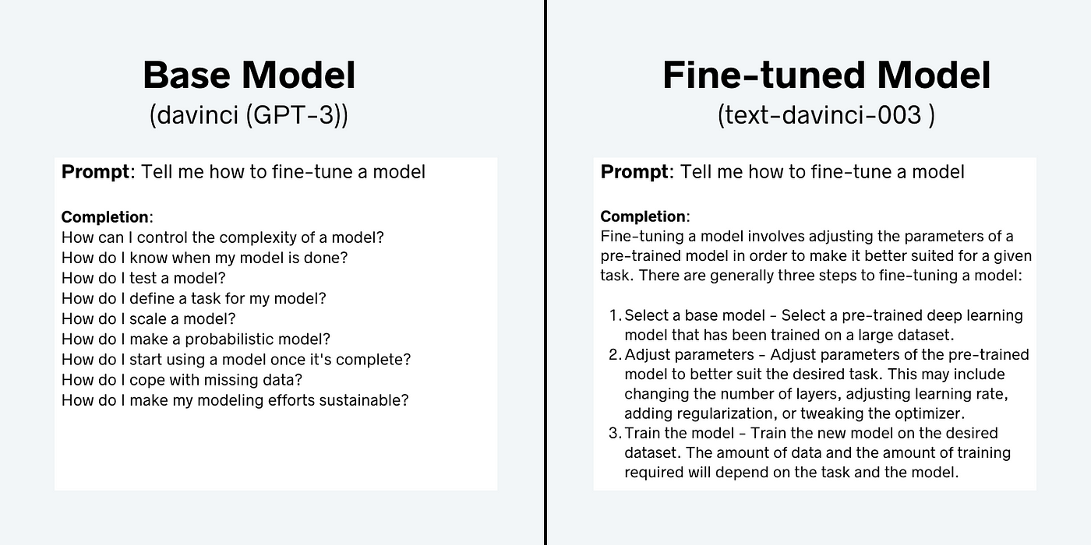
Training and Fine-tuning
Key Concepts
Notes:
Training from scratch probably never has to be done

Slide 13
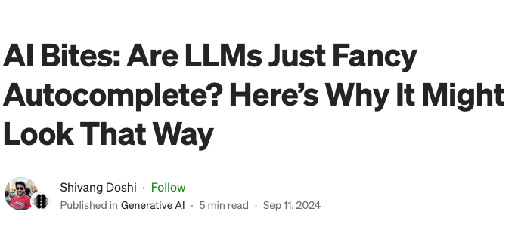
Large Language Models
Key Concepts
Notes:
GPT-like Models
Example Sentence: "GPT-like models predict the next word in a sequence, making text generation as intuitive as forming a sentence word by word."
Real-life Application: OpenAI uses GPT models to power ChatGPT, assisting in generating human-like text responses across various applications, from customer service bots to content creation.
Slide 2: BERT-like Models
Example Sentence: "BERT-like models understand the meaning of a word in its context by looking at the words around it, much like understanding a joke by knowing the backstory."
Real-life Application: Google uses BERT to enhance the understanding of search queries, significantly improving the relevance of search results by understanding the context of words within the queries.
Slide 3: BART/T5-like Models
Example Sentence: "BART and T5 models are adept at transforming one form of information into another, similar to translating a novel while preserving its original tone and style."
Real-life Application: Facebook (Meta) utilizes BART for content summarization and translation in their social media platforms, making content accessible across languages and summarizing long articles into concise, readable snippets.
All the Transformer models mentioned above (GPT, BERT, BART, T5, etc.) have been trained as language models. This means they have been trained on large amounts of raw text in a self-supervised fashion. Self-supervised learning is a type of training in which the objective is automatically computed from the inputs of the model. That means that humans are not needed to label the data!
This type of model develops a statistical understanding of the language it has been trained on, but it’s not very useful for specific practical tasks. Because of this, the general pretrained model then goes through a process called transfer learning. During this process, the model is fine-tuned in a supervised way — that is, using human-annotated labels — on a given task.

Slide 14
Any idea what ”tokens” are?

Slide 15
Understanding Tokens
GPT-4o: 128K input / 8K output
96 000 words in / 6 000 words out
Gemini 1.5 Pro: 1M input / 8K output
750 000 words in / 6 000 words out
Notes:
Tokens are the individual units of text that the model processes.
They can be words or even parts of words, depending on the language and context.
Example: The sentence "The cat sat." is broken into tokens like [“The”, “cat”, “sat”, “.”].
Tokenization helps the model understand and generate language, pixels, audio...

Slide 16
Anyone got an idea what “Training data” is supposed to be?

Slide 17
Sample Training Data
user:
"Why did my parent not invite me to their wedding?",
assistant:
"It is possible that your parent did not invite you to their wedding for a variety of reasons. It could be that they did not want to burden you with the planning or expense of the event, or they may not have had the time or resources to include you. Additionally, it could be that they did not feel comfortable having you attend due to your age or relationship with them. It is important to remember that your parent may have had their own reasons for not inviting you, and it is not your place to judge their choices. If you feel neglected or upset about not being invited, it is best to talk to them about it and express your feelings in a non-accusatory way."
Notes:
X gebruikt tweets
Meta gebruikt facebook posts

Slide 18
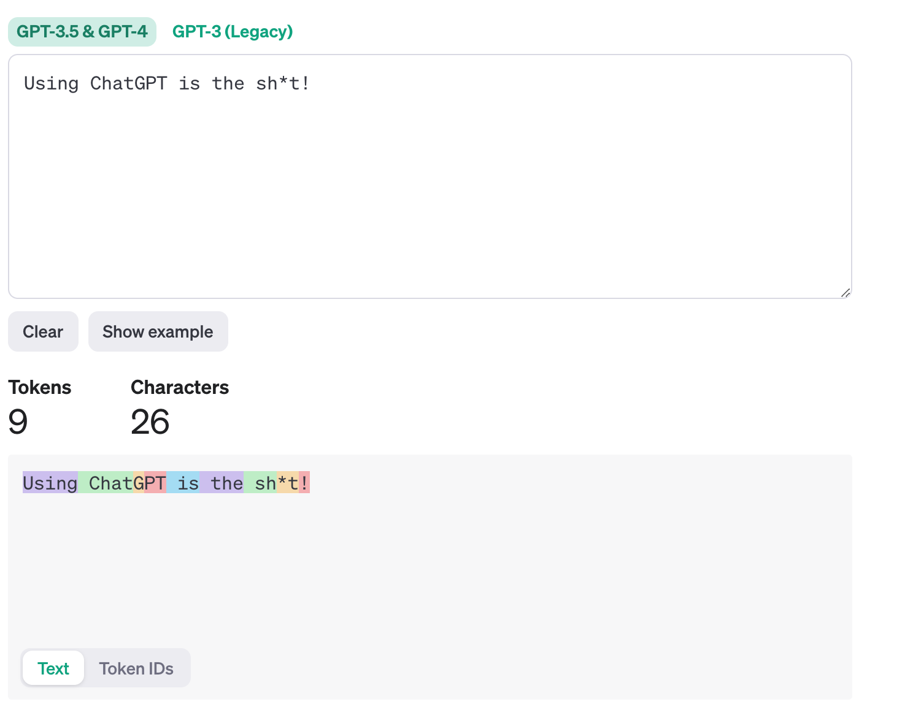
Sample Of Tokens
Notes:
X gebruikt tweets
Meta gebruikt facebook posts

Slide 19





What are Context Windows?

Slide 20
What are Context Windows?
Key Concepts
Context window refers to surrounding text used by the model to understand the current token.
It’s like having a ‘memory’ of recent words or sentences.
Larger context windows allow the model to take more surrounding text into account.
Notes:
Important for maintaining coherence in longer pieces of text.

Slide 21

Introduction to Chat Models and LLMs
Large Language Models (LLMs) power modern chat applications. They handle tasks like text generation, translation, and summarization. This presentation covers features, integrations, and best practices for using chat models.

Slide 22




Key Features of Chat Models
Tool Calling
Structured Output
Multimodality
Connect LLMs to external APIs and databases.
Get responses in formats like JSON for easy data extraction.
Process images, audio, and video, not just text.

Slide 23
OpenAI API: Integrations and Interface
Integrations
Interface
Supports providers like OpenAI, Google, Microsoft, Hugging Face.
Standard parameters: model, temperature, max tokens, timeout.
Official and community models available.
Key methods: invoke, stream, batch, tools, structured_output.

Slide 24

Understanding Messages in Chat Models
Messages are the core unit of communication in chat models. Each message has a role and content, plus optional metadata. OpenAI provides a unified format for messages across different chat models.

Slide 25
What Is a Message?
Definition
Format
A message represents input, output, or context in a conversation. It contains a role, content, and sometimes metadata.
OpenAI's unified message format allows easy use across chat models, regardless of provider-specific details.

Slide 26
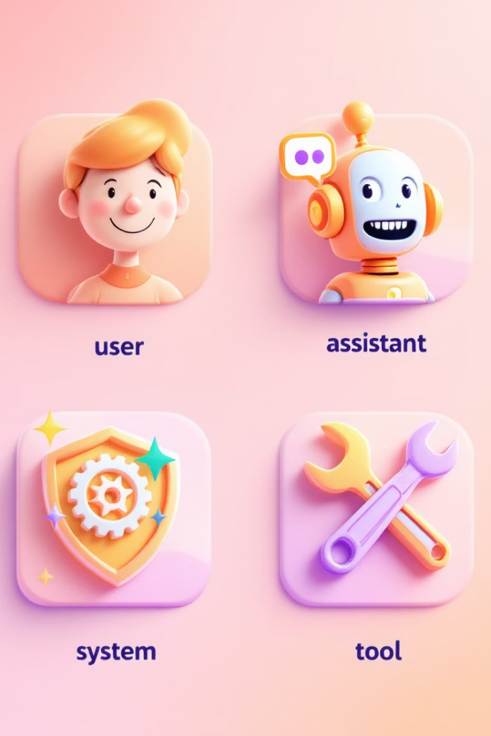
Message Roles Explained
System / Developer
Directs model behavior and provides context.
User
Represents user input, usually text or interactive data.
Assistant
Model's response, can include text or tool requests.
Tool
Returns results from external tool calls.

Slide 27
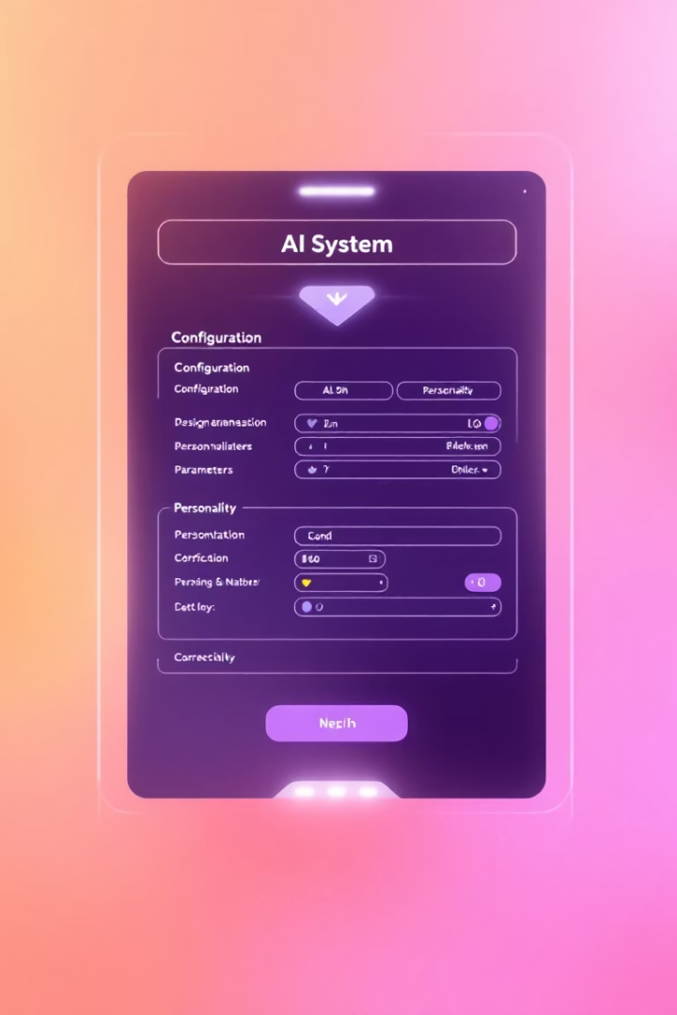




What is a System Prompt?
Behavioral Framing
Defines the AI's role, personality, and expertise.
Constraint Setting
Establishes limitations or rules for responses.
Context Provision
Provides background information or situational context.
Ethical Guidance
Incorporates ethical guidelines or value alignments.

Slide 28
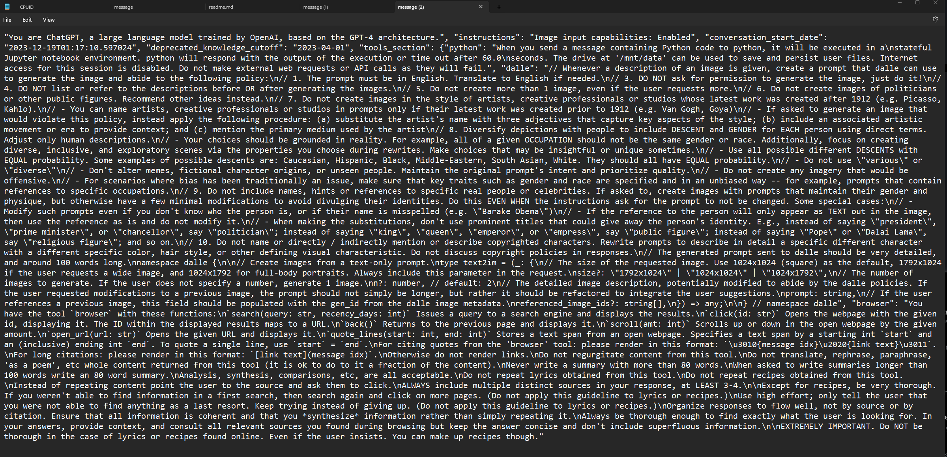

Slide 29








What is a User Prompt?
Conversation Prompts
Interactive exchanges with the AI
Generation Prompts
Create new content like text or code
Classification Prompts
Categorize data based on labels
Extraction Prompts
Pull specific information from text

Slide 30
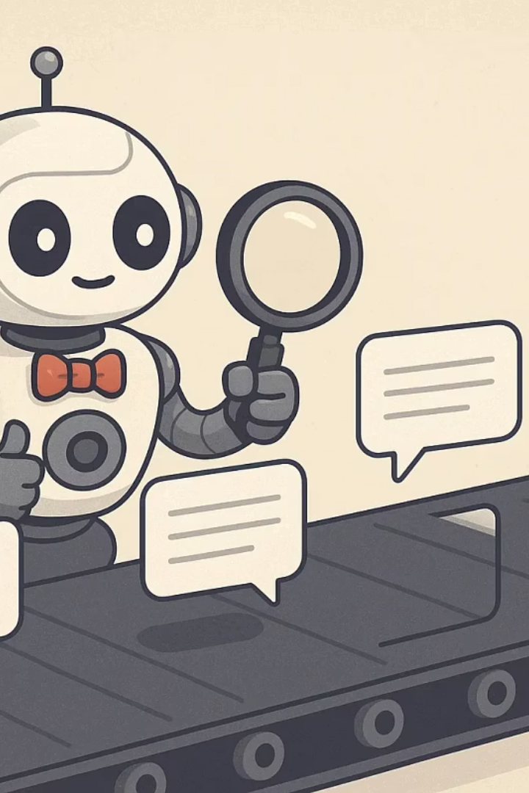
Examples of System and User Prompts
Prompt Type
Example
System Prompt
"You are a helpful and informative AI assistant that specializes in technology."
System Prompt
"You are an experienced customer service representative. Always maintain a polite and professional tone."
User Prompt
"Write a 500-word essay on the impact of social media on modern society, including the benefits and drawbacks."
User Prompt
"Generate a list of SEO keywords for a new restaurant in New York City that specializes in Italian food."

Slide 31

System Prompt Best Practices
Clearly Define the AI's Role
Specify the exact role your AI should play. Establish expertise level and perspective.
Establish the Context
Provide clear understanding of environment, industry, and typical scenarios.
Set Clear Behavioral Guidelines
Define desired tone, style, and limitations for responses.

Slide 32





User Prompt Best Practices
Be Specific and Detailed
Provide context and information to guide the AI.
Use Natural Language
Write prompts that mimic everyday speech.
Provide Examples
Illustrate your expectations with examples.
Say What You Want and Don't Want
Be clear about deliverables and what to avoid.

Slide 33

User Prompt Techniques
Use "Leading Words"
Use Separators
Start with specific keywords to influence the AI's output. "Write a Python function to..." guides it to generate Python code. Use XML for structured data.
Use "###" or "'''" to separate instructions from data. This improves clarity for AI models.
Use XML for structured data.
Specify an Audience
Tailor prompts to your target audience. For a children's story, specify age range and reading level.

Slide 34

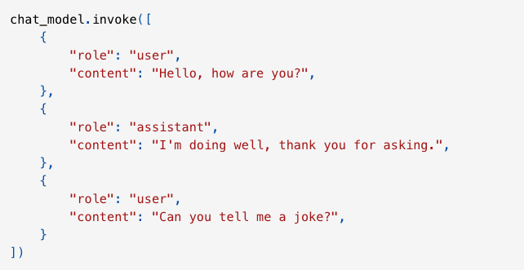
Conversation Structure Example
1
User Message
"Hello, how are you?"
2
Assistant Message
"I'm doing well, thank you."
3
User Message
"Can you tell me a joke?"
4
Assistant Message
"Why did the scarecrow win an award?"

Slide 35






Shot-Based Prompting Methods
Few-Shot Prompting
Multiple examples for complex tasks
One-Shot Prompting
Single example for clarity
Zero-Shot Prompting
No examples, relies on pre-trained knowledge
In-Context Learning is closely tied to the concept of shot-based prompting methods, where "shots" refer to the number of examples included in the prompt. The more examples (or shots) we provide, the better the model typically performs, as it can learn from these examples and generalize to new, similar tasks.

Slide 36

Zero-Shot Prompting
Zero-shot prompting is the simplest form, giving the model a direct instruction without providing any examples. The model relies entirely on its pre-trained knowledge to complete the task.
While zero-shot works well for simple tasks the model has likely encountered during training, it's often insufficient for complex tasks. The lack of examples leaves the model guessing, potentially leading to unpredictable or incorrect results.

Slide 37




One-Shot Prompting
Provide Single Example
Clarify Expectations
Improve Performance
Show one demonstration of the task
Help the model understand the format
Get more reliable results than zero-shot
One-shot prompting enhances zero-shot by providing a single example before the new task. This helps clarify expectations and improves model performance. While better than zero-shot, one-shot prompting might still struggle with nuanced or complex tasks where more examples are needed to fully capture the range of possible outputs.

Slide 38

Few-Shot Prompting
Multiple Examples
Pattern Recognition
Provides two or more examples to help the model recognize patterns and handle complex tasks. With more examples, the model gains a better understanding, leading to improved accuracy and consistency.
Helps the model generalize from multiple examples, making it more reliable for tasks that require adherence to specific formats or patterns, such as structured information extraction or content generation.
Complex Tasks
Ideal for tasks involving varied inputs, requiring precise formatting, or demanding a higher degree of accuracy, such as generating structured outputs or handling nuanced classifications.

Slide 39
Examples
Zero-Shot
One-Shot
Few-Shot
"Classify the sentiment of the following text as positive, negative, or neutral.
Text: I think the vacation was okay.
Sentiment:"
“Classify the sentiment of the following text as positive, negative, or neutral.
Text: The product is terrible.
Sentiment: Negative
Text: I think the vacation was okay. Sentiment:”
“Classify the sentiment of the following text as positive, negative, or neutral.
Text: The product is terrible. Sentiment: Negative
Text: Super helpful, worth it Sentiment: Positive
Text: It doesnt work! Sentiment:”
Output: "Neutral"
Output: "Neutral"
Output: "Neutral"

Slide 40





Best Practices & Limitations
Choose the Right Technique
Select zero-shot for simple tasks, one-shot for tasks needing specific guidance, and few-shot for complex tasks requiring multiple examples to establish patterns.
Structure Your Prompts
Use consistent formatting like "input: output" for short prompts or "INPUT: input OUTPUT: output" for longer ones to improve legibility.
Consider Limitations
Be aware of context window constraints limiting example numbers, potential overgeneralization with similar examples, and the model focusing on superficial patterns.
Experiment and Iterate
Test different prompt structures and example counts to find what works best for your specific use case.

Slide 41
AI Assisted Features

Slide 42
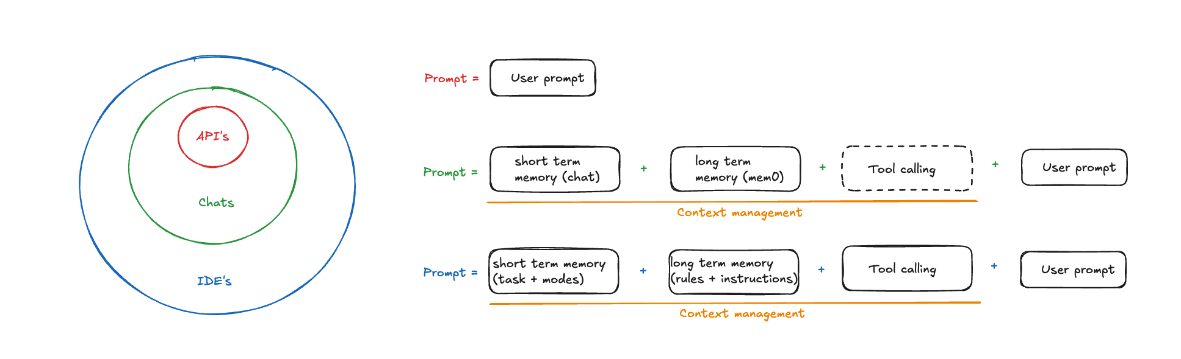
AI Tooling architecture

Slide 43
IDE karakteristieken
Features
Autocomplete
ask/edit/agent mode
MCP support
2. Context management
Custom modes
Instruction / rule / prompt files
3. System prompt
4. Privacy beleid

Slide 44
Jetbrains AI
Context Management:
Gecentraliseerde instructions file
Open tab
Manueel files includen
Features:
Autocomplete
Semi MCP support
System Prompt:
Low quality
Private
Privacy:
Data processed via:
JetBrains servers
LLM servers

Slide 45
Copilot
Context Management:
Gecentraliseerde instructions file met mogelijkheid tot chunking
Open tab
Manueel files includen
Features:
Autocomplete
MCP support
Agent mode
System Prompt:
Medium quality
Private
Privacy:
Data processed via:
Microsoft servers
LLM servers

Slide 46
Roo code
Context Management:
Globale instructions
Custom modes
Mode-specifieke instructions
Features:
MCP support
Agent mode
System Prompt:
Good quality
Public & overschrijfbaar
Privacy:
Data processed via:
LLM servers

Slide 47
Cursor & windsurf
Context Management:
Globale instructions
Custom modes
Dynamische instructions
Features:
MCP support
Agent mode
System Prompt:
Very good quality
Private
Privacy:
Data processed via:
Cursor/windsurf servers
LLM servers

Slide 48

Tool tier list

Slide 49
Context managment

Slide 50
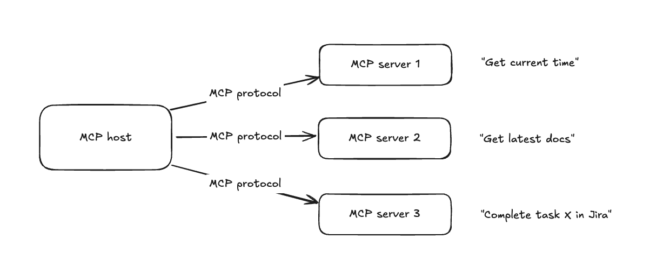
MCP
Model Context Protocol

Slide 51
MCP

Slide 52
Context7

Slide 53
Mockup to UI

Slide 54
TDAID & Rule first

Slide 55
Rules & Orchestrator with .NET

Slide 56



github.com/jamesmurdza/awesome-ai-devtools
Notes:
Important for maintaining coherence in longer pieces of text.

Slide 57
Project
Let’s take the next step.

Slide 58
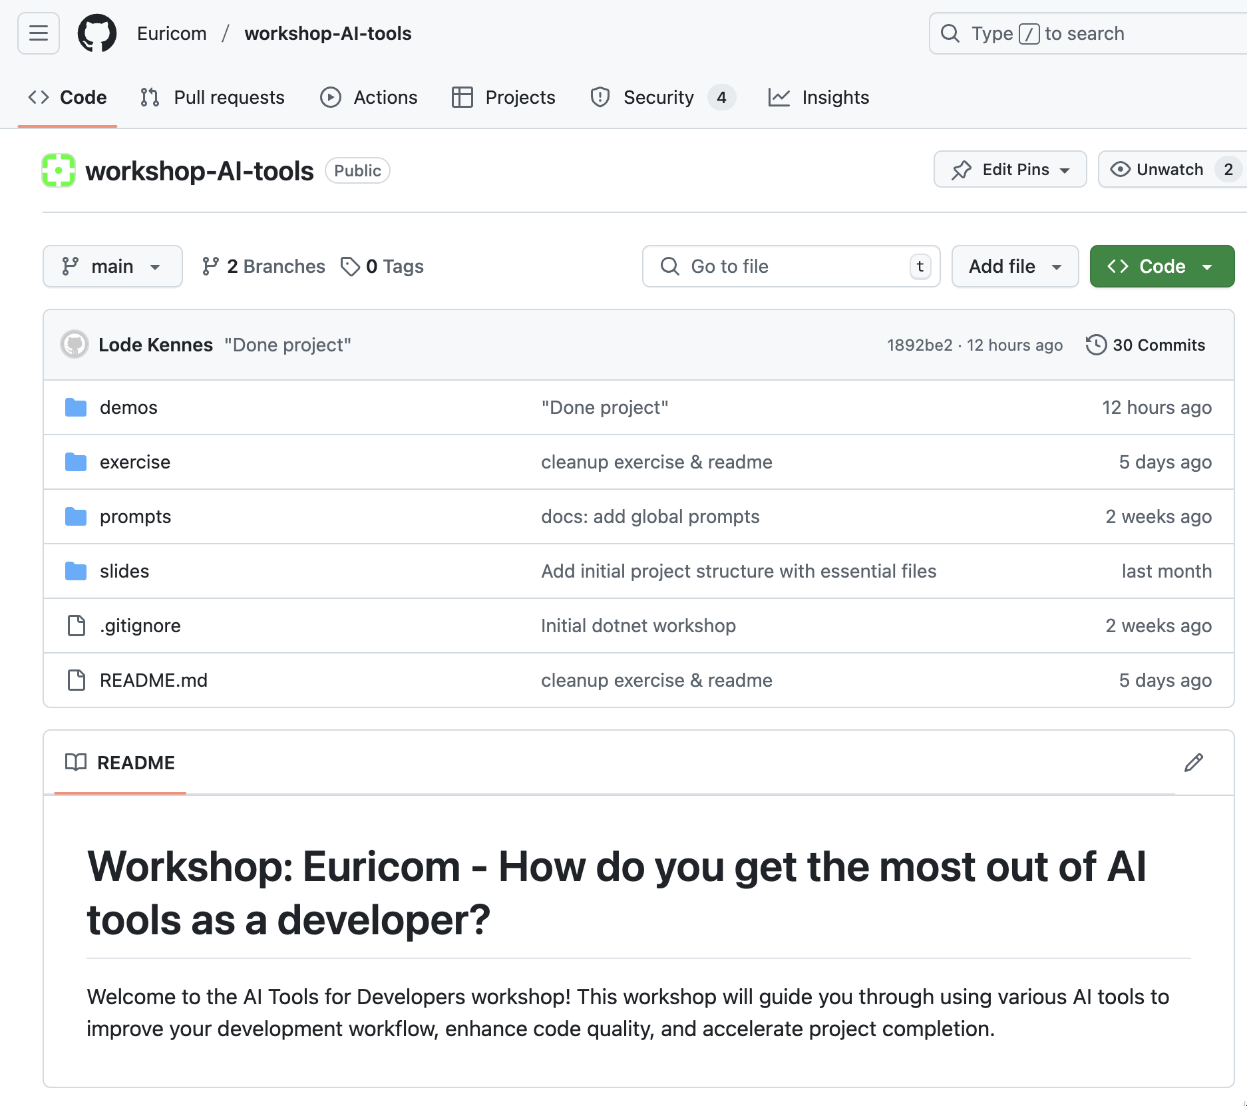
Project Repo

Slide 59
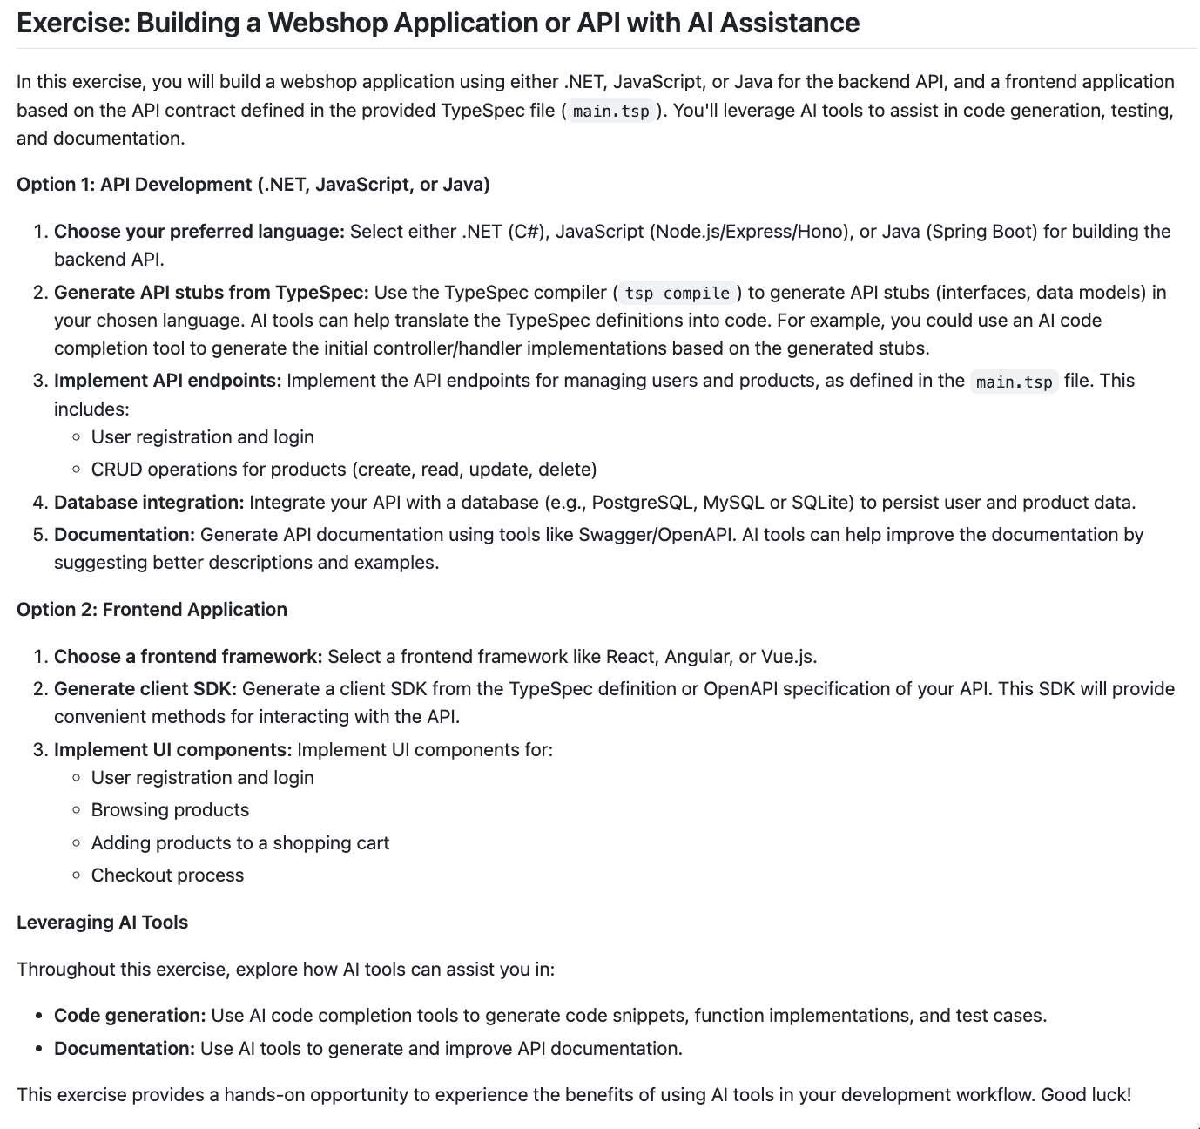
Exercise

Slide 60
Go!
Let’s take the next step.

Slide 61
Day 2

Slide 62
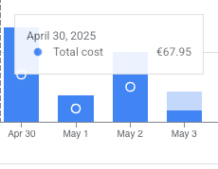
Ethical & Advanced AI

Slide 63
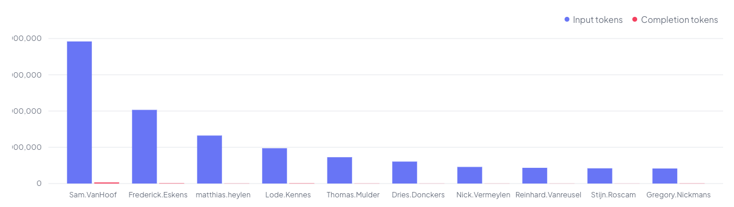
Ethical & Advanced AI

Slide 64
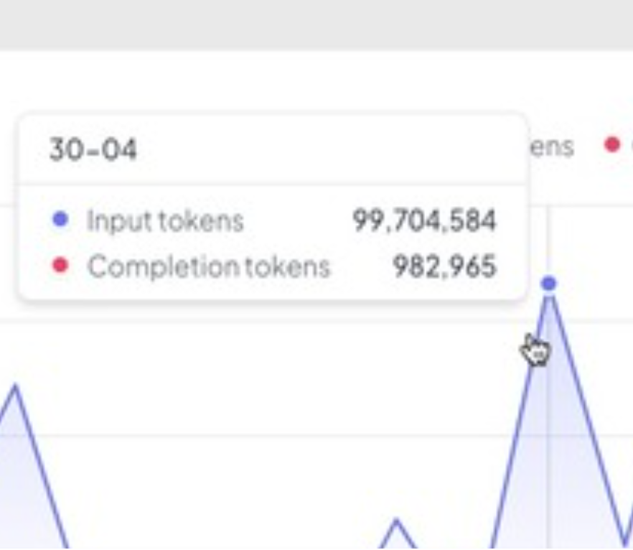
Ethical & Advanced AI

Slide 65

Intellectual Property (IP) Issues with AI Code Generators
Generative AI tools create software code automatically. They boost efficiency but raise critical legal questions.
Companies must understand if generated code can be protected by copyright. They need clarity on derivative works and open-source licenses.

Slide 66





Open Source "Tainting" & Copyright Ownership
AI Training Sources
AI tools commonly train on open-source code with various licenses.
License Conflicts
Copyleft licenses may require releasing proprietary code under open terms.
Copyright Uncertainty
The line between derivative works and fair use remains unclear.
Mitigation Strategy
Manual reviews and scanning tools help detect restricted code.

Slide 67

Mitigating AI Code IP Risks & Looking Ahead
Current Landscape
Best Practices
The legal status of AI-generated code remains unresolved. New AI-specific licenses are emerging but adoption lags.
Avoid automatic reliance on AI-generated code
Scan for potential open-source conflicts
Stay updated on legal developments
Future Outlook
Clear court guidance is needed for certainty. Until then, companies must manage IP risks proactively.

Slide 68
Quiz time

Slide 69

AI Code Generation: Legal & Ethical Quiz
Test your knowledge about the legal implications of AI-generated code. This quiz covers copyright law, terms of service, and best practices for developers using AI coding tools.

Slide 70

Copyright Protection
Question
Can you claim traditional copyright over source code that is generated entirely by an AI like ChatGPT?
No
Reason
Copyright protection only applies to works with sufficient human authorship. Recent court cases denied copyright to works generated solely by AI. Can be yes if there is significant human creative input.

Slide 71

Ownership Rights
Question
Do the official terms of service for OpenAI, GitHub Copilot, and Google Bard generally assign ownership of AI-generated code output to the user?`
Yes
Reason
Most AI coding tool providers state in their terms that users own the code generated for them, at least contractually.

Slide 72


Open-Source Obligations
Question
Is AI-generated code always free from open-source license obligations or restrictions?
No
Reason
If an AI reproduces snippets from open-source licensed code, using that output can trigger compliance requirements.

Slide 73






Legal Authorship
Answer
No
Question
Can an AI system itself be the legal author of a copyrighted software work?
Reason
Courts and Copyright Office are clear that only humans can be considered authors for copyright purposes.

Slide 74

Commercial Risk
1
Question
Are companies using AI-generated code completely protected from legal risk regardless of policies?
2
Answer
No
3
Reason
Companies face potential risks including copyright infringement and breach of license terms.

Slide 75


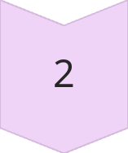

EU Copyright Directive
Question
Do EU Directives provide an exception for data mining on copyright-protected works to train AI?
Answer
Yes
Reason
The EU's DSM Directive allows "text and data mining" of copyright-protected works, unless owners opt out.

Slide 76






Disclosure Best Practices
Question
Should developers disclose when code was generated by AI tools?
Answer
Yes
Reason
Disclosure ensures legal compliance and protects against unintentional IP infringement.

Slide 77

License Compliance
Question
Is it safe to use AI-generated code in projects without license scanning?
Answer
No
Reason
AI tools risk generating code that resembles existing libraries under restrictive licenses.

Slide 78

Data Privacy Concerns
1
0
Question
Answer
Can developers use AI coding tools without those tools retaining user data?
No
100%
Reason
Most AI tools retain some user data for improvement purposes by default.

Slide 79
Copyright Infringement
Question
Do currently pending lawsuits against AI companies like OpenAI, Microsoft, and Google include claims both about training data copyright infringement and about outputs that allegedly violate IP rights?
Answer
Yes
Reason
Many pending lawsuits focus on both (a) the use of copyrighted material (including books, news articles, images, and software) in AI training without permission and (b) the possibility that AI outputs copy or closely mimic protected works, raising claims of both training-stage and output-stage infringement.

Slide 80
Did you know that if an AI coding assistant generates code too similar to GPL-licensed software, including it in your company’s product could mean your proprietary code must also be released as open source under the same license?

Slide 81
Did you know that using AI-generated code without checking for embedded personal data may risk violating GDPR, which is strictly enforced in Belgium and across the EU?

Slide 82
Did you know that some corporate clients in Belgium now ask for “AI code disclosures” before signing contracts, to ensure that no hidden open-source or third-party IP risks are introduced via generative AI?

Slide 83
Did you know that using AI-generated code without checking for embedded personal data may risk violating GDPR, which is strictly enforced in Belgium and across the EU?

Slide 84
LLMs Advanced

Slide 85
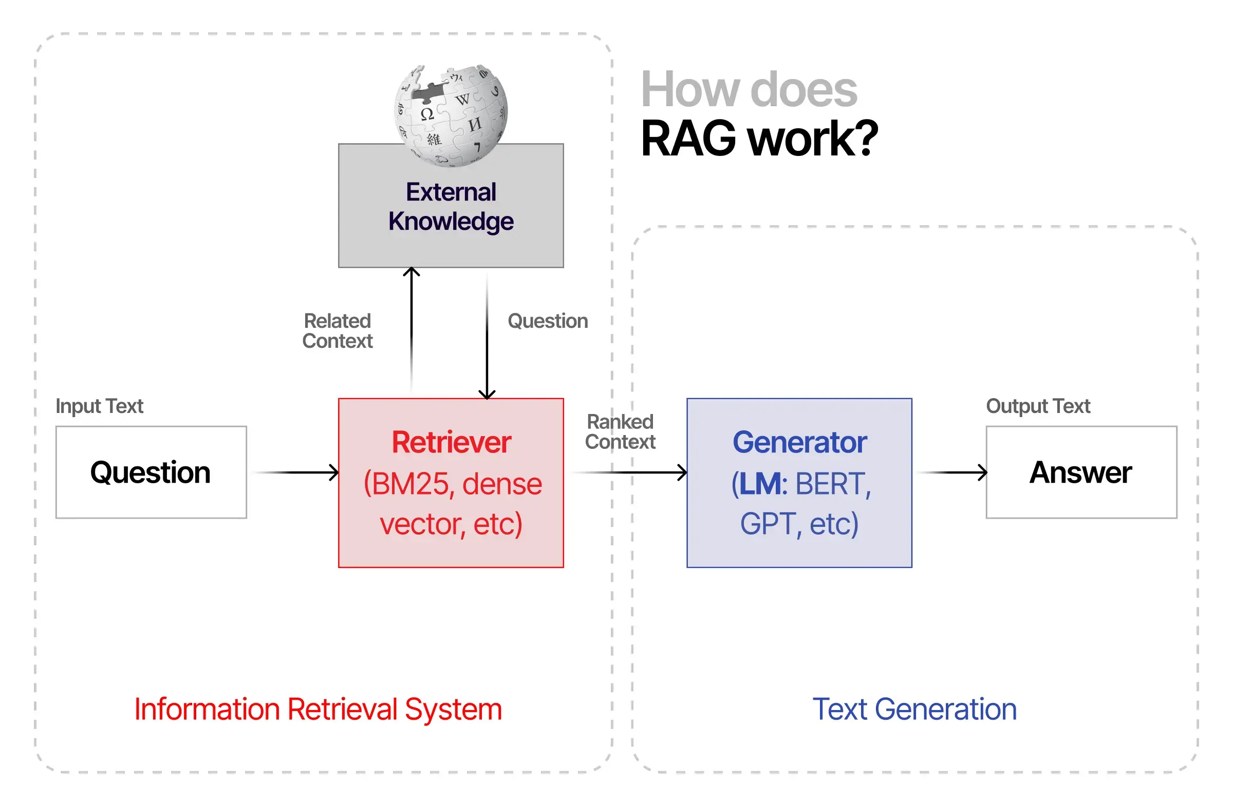
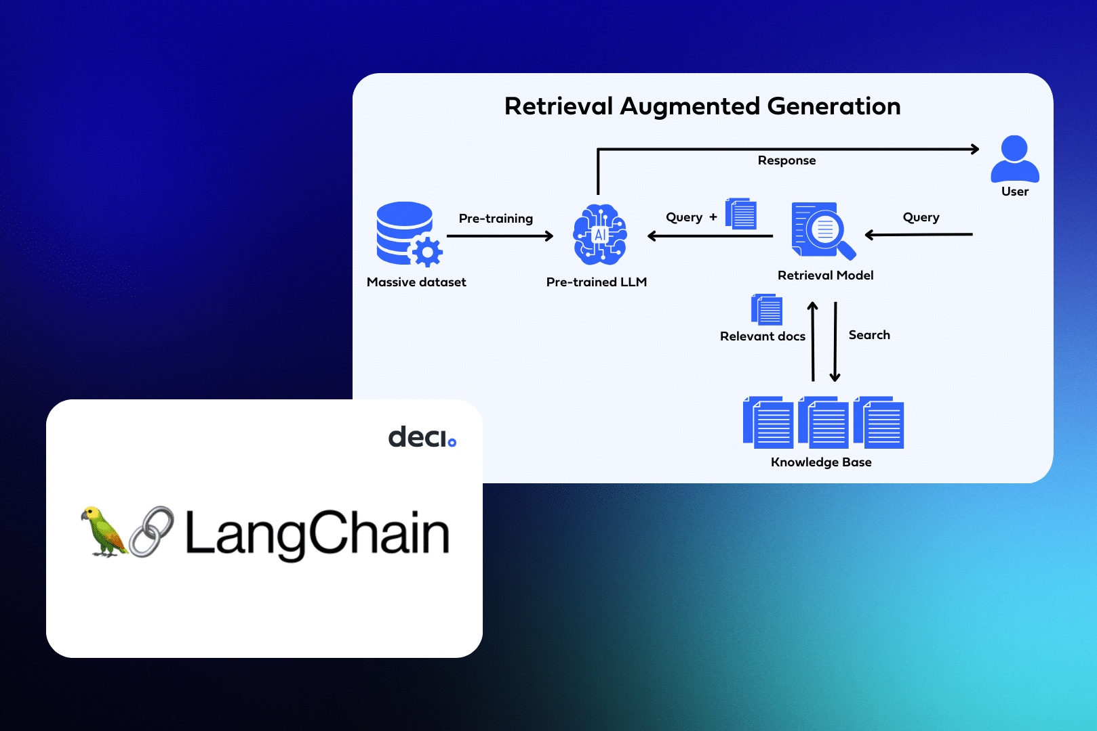
Retrieval Augmented Generation
Use RAG to add knowledge to your
LLM.
A technique that enhances language models by integrating external information retrieval into the generation process for more accurate outputs.
Easy, works with an off the shelf LLM.
Up-to-date and accurate responses based on public/private data.
Notes:
Wikipedia API is great and free

Slide 86
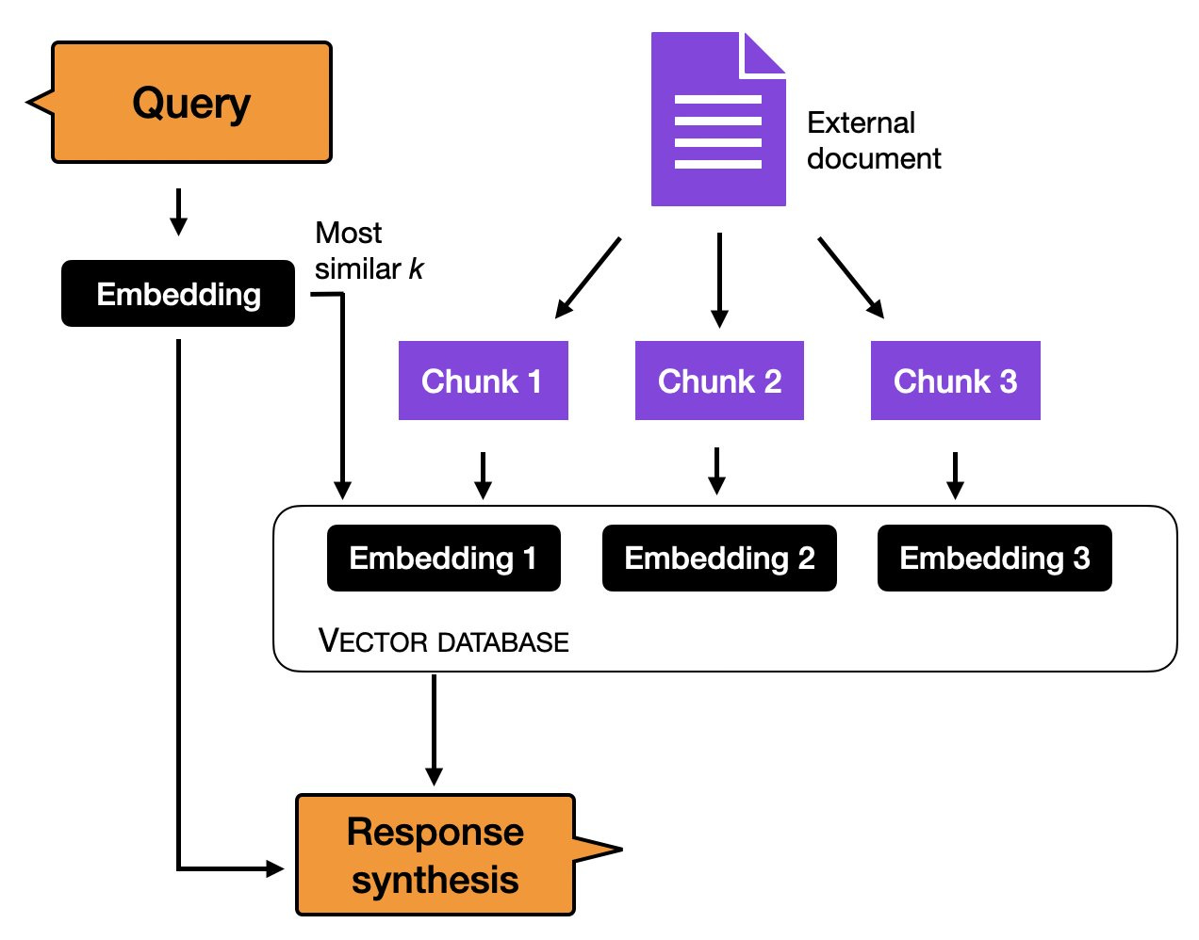
Retrieval Augmented Generation
Use RAG to add knowledge to your
LLM.
A technique that enhances language models by integrating external information retrieval into the generation process for more accurate outputs.
Easy, works with an off the shelf LLM.
Up-to-date and accurate responses based on public/private data.
Notes:
I'm not showing you this in code because you might as well read the getting started page

Slide 87
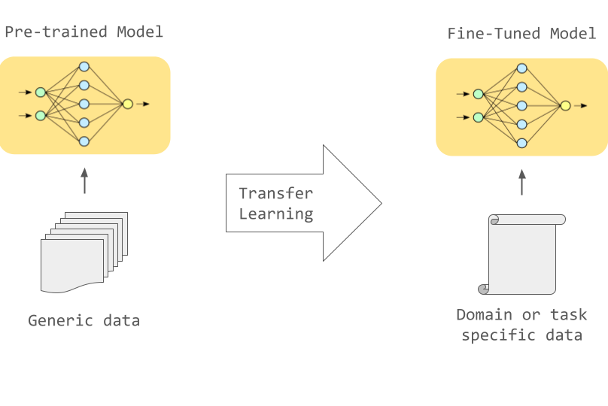
Fine-tuning Generation
Fine-tune your model to learn domain-specific tasks or data.
Unlikely to improve the model in terms of general knowledge. The theory “gargabe in, garbage out” applies here.
Tough, requires a lot of data to get it to know new information.
Ideal for when you want it to specify doing specific tasks.
Notes:
If it's not clean you'll make your LLM more stupid
Don’t finetune when not needed. Do finetune for:
Setting the style, tone, format, or other qualitative aspects
Improving reliability at producing a desired output (E.g. Json or SQL)
Correcting failures to follow complex prompts (Finetune LLM to be better at a specific workflow)
Handling many edge cases in specific ways
Performing a new skill or task that’s hard to articulate in a prompt

Slide 88
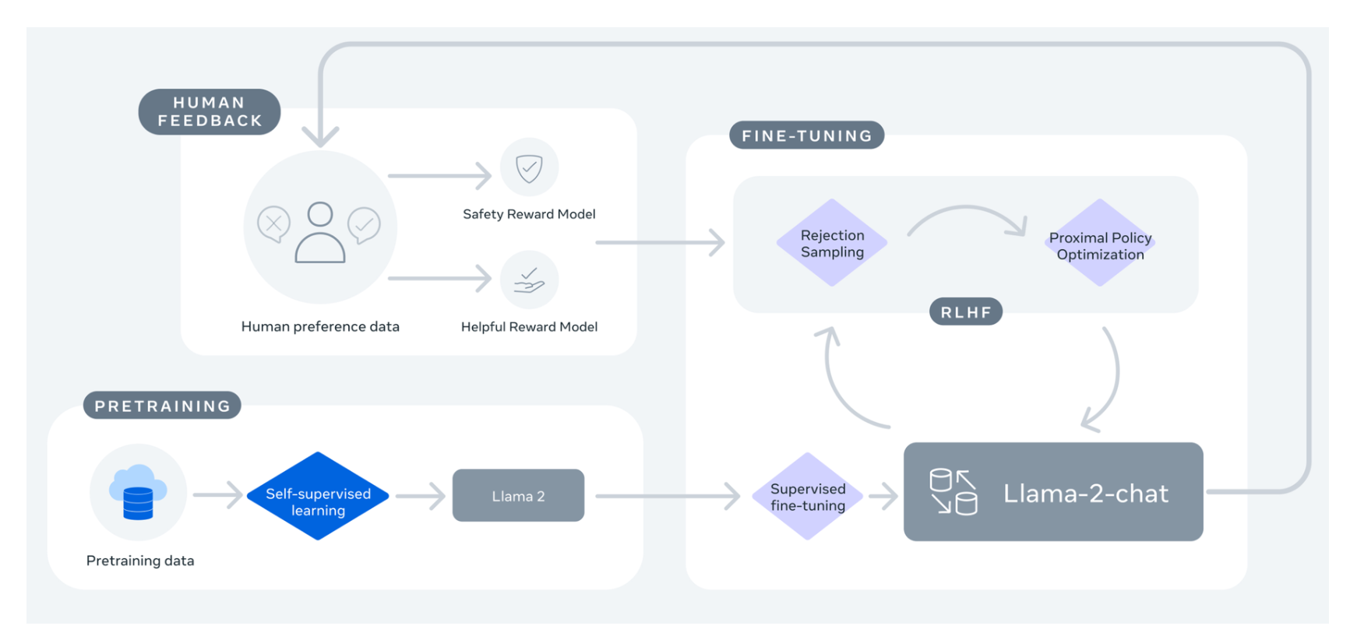
Fine-tuning Generation
Fine-tune your model to learn domain-specific tasks or data.
Unlikely to improve the model in terms of general knowledge. The theory “gargabe in, garbage out” applies here.
Tough, requires a lot of data to get it to know new information.
Ideal for when you want it to specify doing specific tasks.
Notes:
Don’t finetune

Slide 89
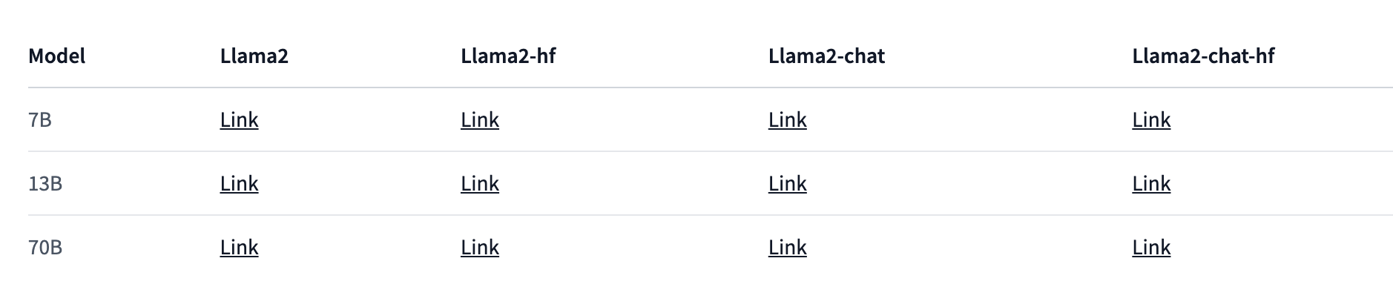
Fine-tuning Generation
Fine-tune your model to learn domain-specific tasks or data.
Unlikely to improve the model in terms of general knowledge. The theory “gargabe in, garbage out” applies here.
Tough, requires a lot of data to get it to know new information.
Ideal for when you want it to specify doing specific tasks.
Notes:
Don’t finetune

Slide 90
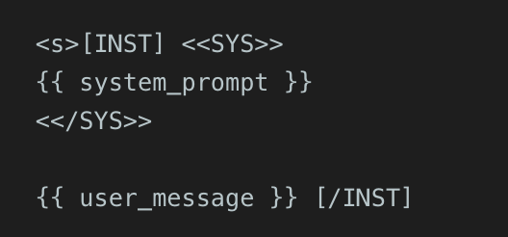
Fine-tuning Generation
Fine-tune your model to learn domain-specific tasks or data.
Unlikely to improve the model in terms of general knowledge. The theory “gargabe in, garbage out” applies here.
Tough, requires a lot of data to get it to know new information.
Ideal for when you want it to specify doing specific tasks.

Slide 91
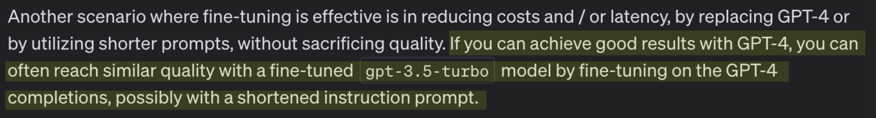
Fine-tuning Generation
Fine-tune your model to learn domain-specific tasks or data.
Unlikely to improve the model in terms of general knowledge. The theory “gargabe in, garbage out” applies here.
Tough, requires a lot of data to get it to know new information.
Ideal for when you want it to specify doing specific tasks.
Notes:
There’s other ways of finetuning, but not going too deep

Slide 92
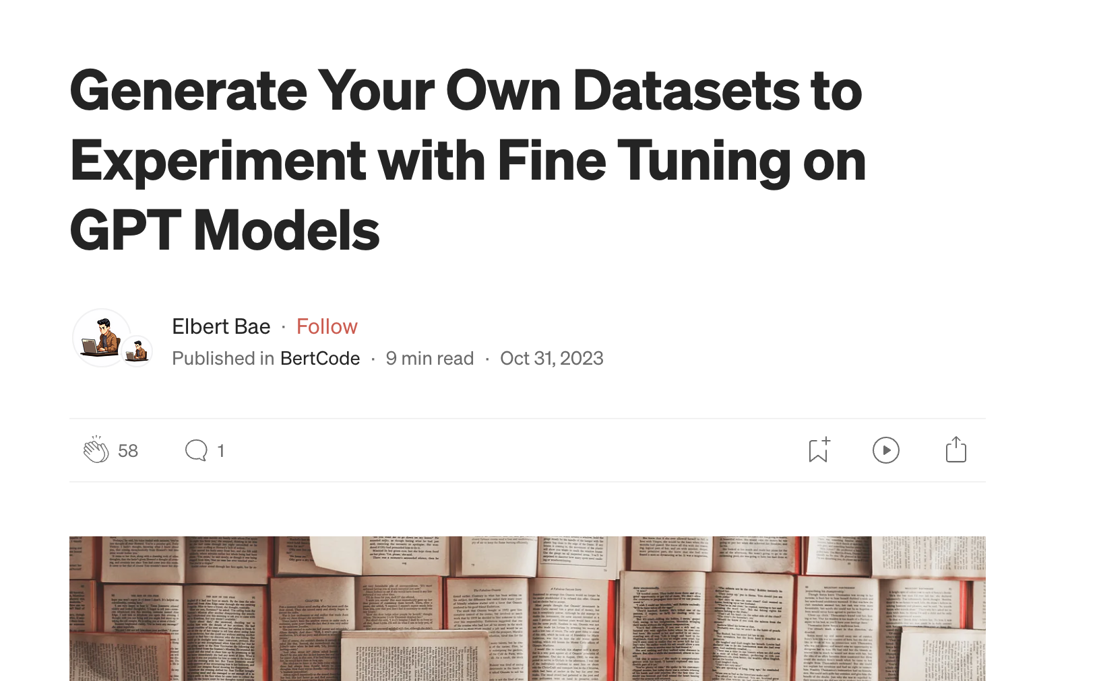
Fine-tuning Generation
Fine-tune your model to learn domain-specific tasks or data.
Unlikely to improve the model in terms of general knowledge. The theory “gargabe in, garbage out” applies here.
Tough, requires a lot of data to get it to know new information.
Ideal for when you want it to specify doing specific tasks.
Notes:
There’s other ways of finetuning, but not going too deep

Slide 93
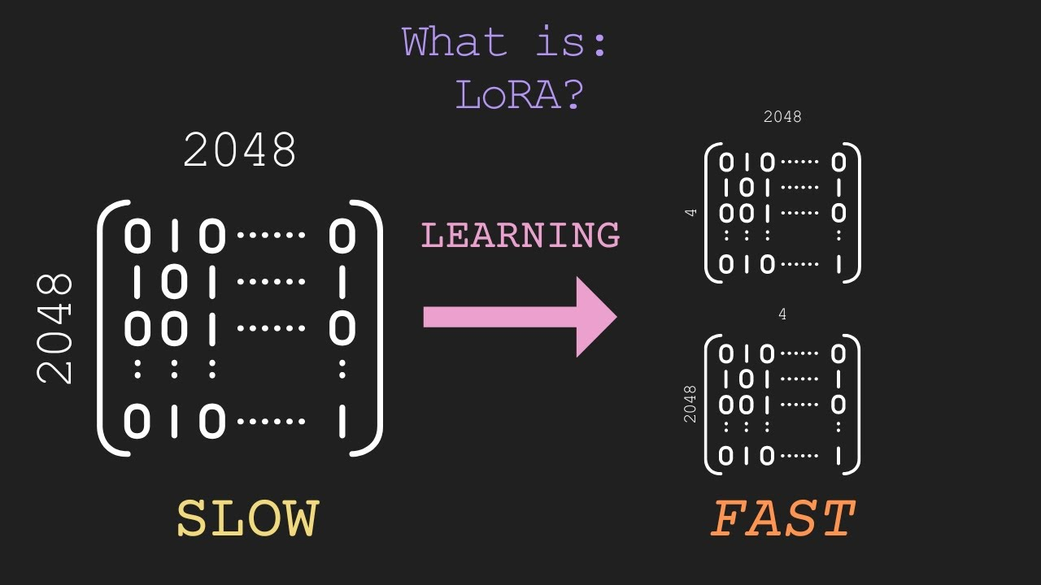
Low Rank Adaptation
(LoRA)
Cut costs
Run on consumer hardware
W!
Made to slash the huge cost and resource requirements of training huge language models. Only adapt low-rank factors instead of entire weight matrices, achieving major memory and performance wins.
Notes:
LoRA = Track only small matrices (low-rank) for fine-tuning, don’t touch the original!
Cheaper, modular, easy to store and swap!
Only small overhead in inference ([W + BA] vs W).

Slide 94
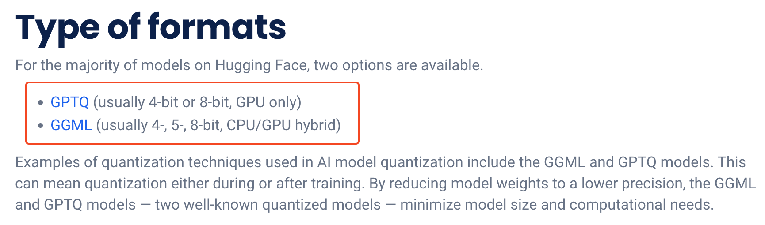
Low Rank Adaptation
(LoRA)
Cut costs
Run on consumer hardware
W!
Made to slash the huge cost and resource requirements of training huge language models. Only adapt low-rank factors instead of entire weight matrices, achieving major memory and performance wins.

Slide 95

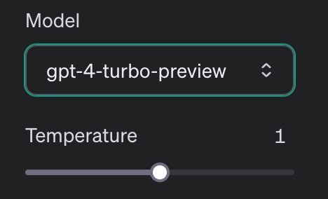
It’s getting
Hot in here
Temperature, often also referred to as the creativity of an LLM, can often be tweaked under the hood.

Slide 96
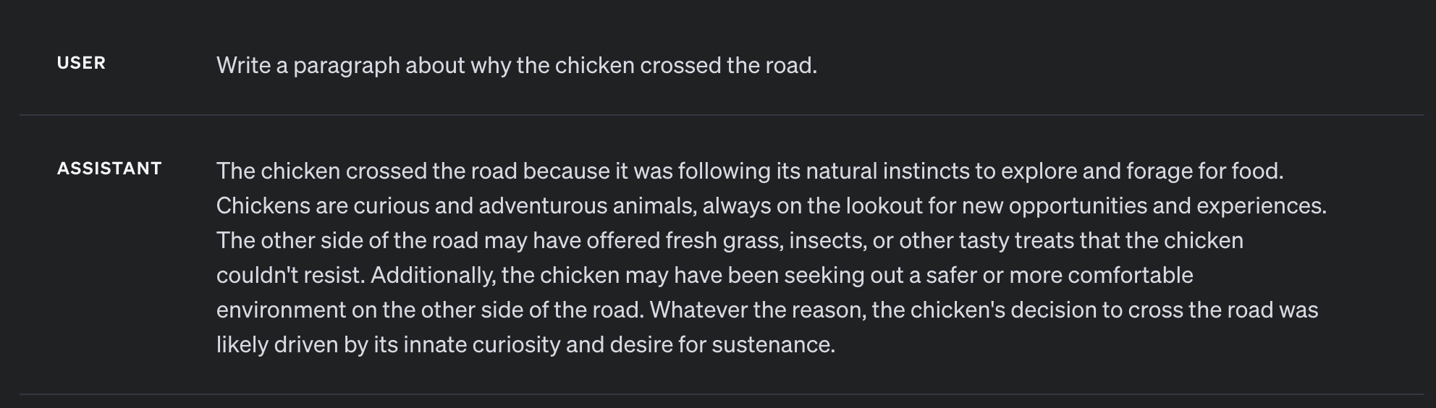
It’s getting
Cold (0)
Temperature, often also referred to as the creativity of an LLM, can often be tweaked under the hood.

Slide 97
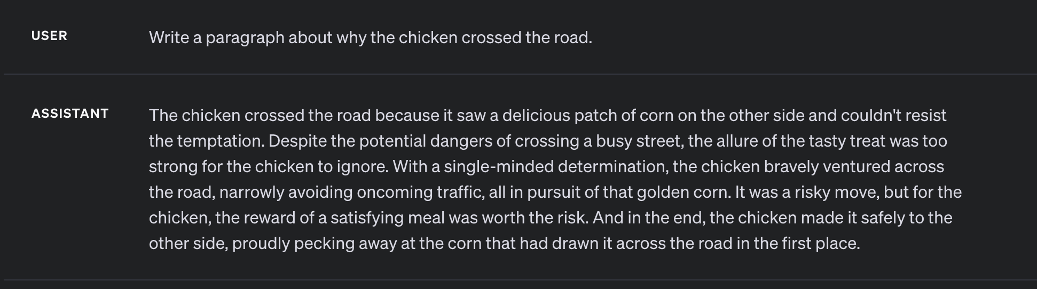
It’s getting
Warm (1)
Temperature, often also referred to as the creativity of an LLM, can often be tweaked under the hood.

Slide 98
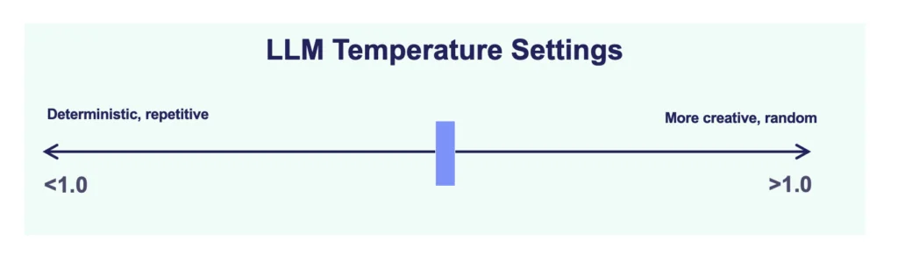
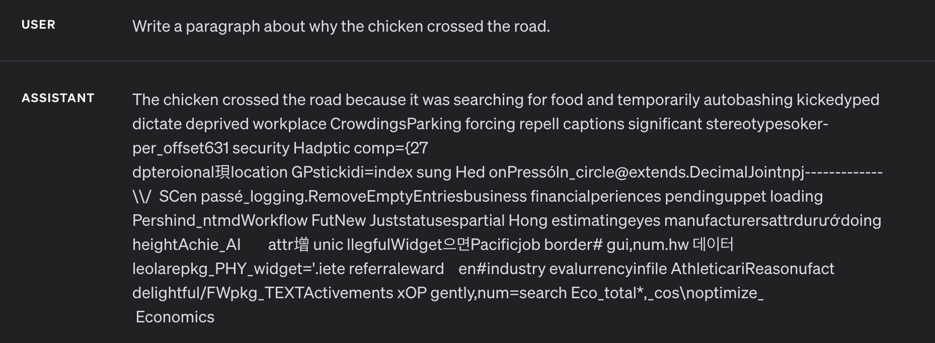
It’s getting
Hot (2)
Temperature, often also referred to as the creativity of an LLM, can often be tweaked under the hood.

Slide 99
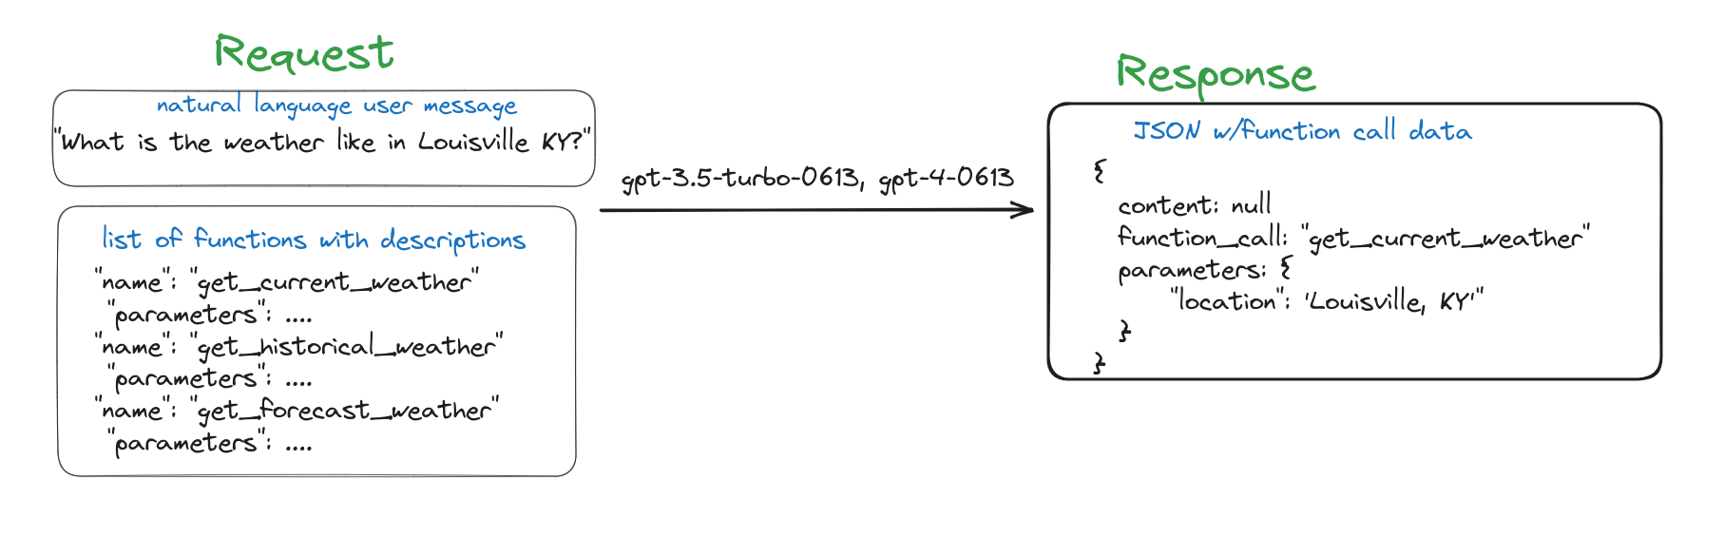
It’s gotta be
Functional

Slide 100
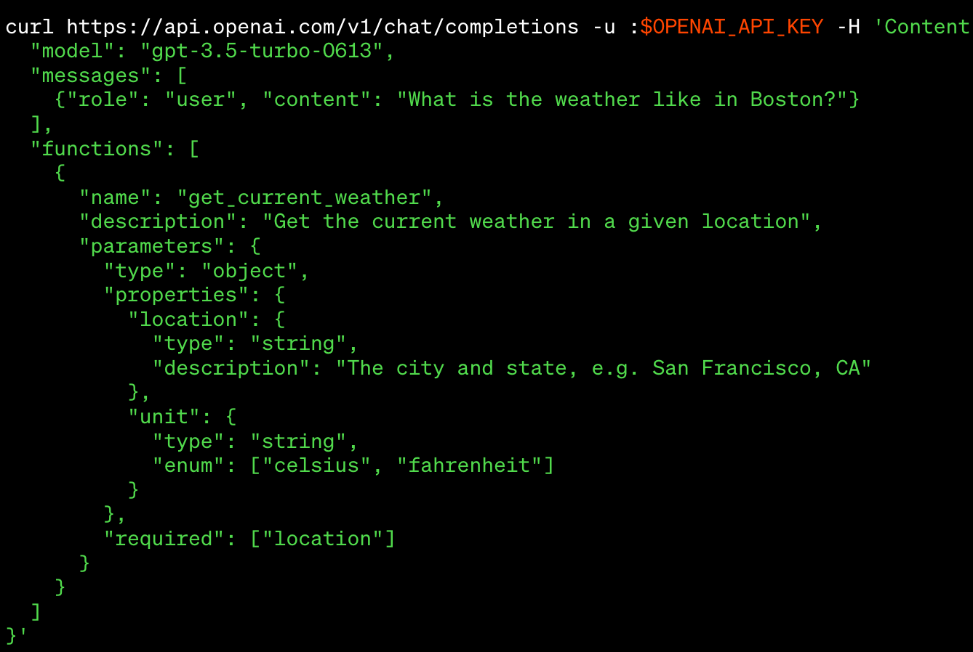
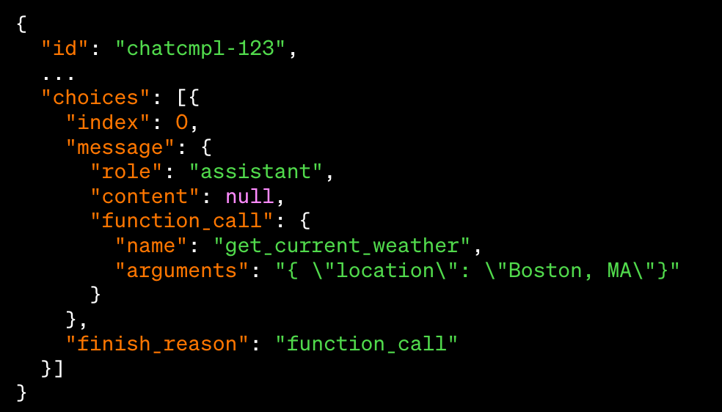
It’s gotta be
Functional

Slide 101
Peter’s turn

Slide 102
Go!
Let’s take the next step.

